Slide 1

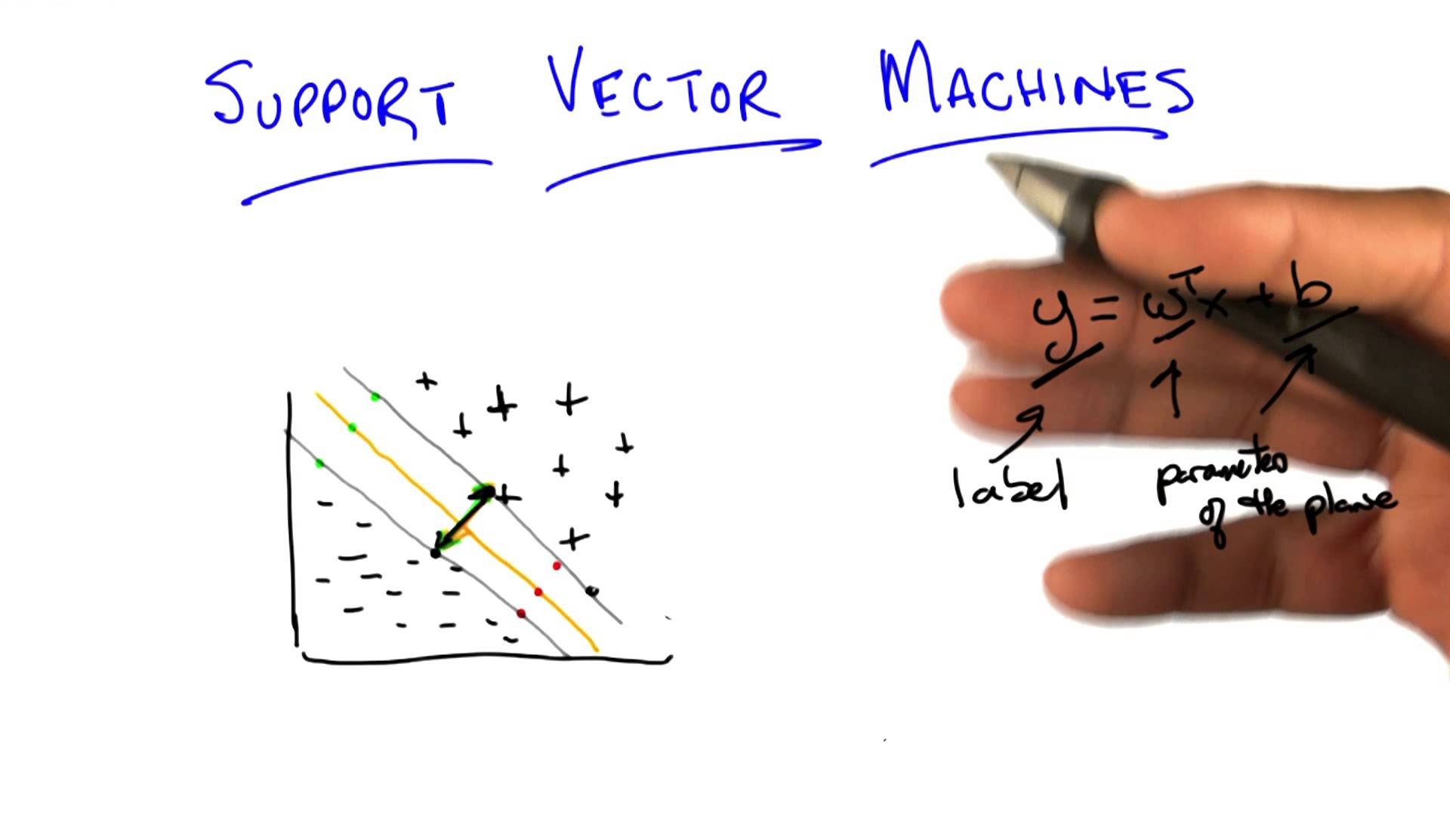
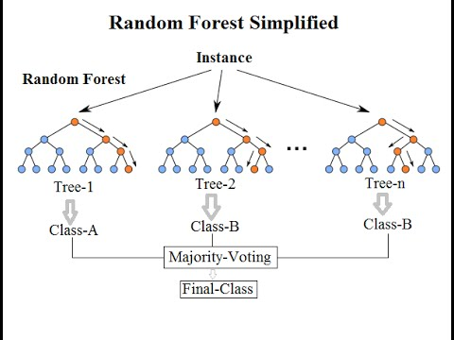
Maximizing bank’s marketing campaign profitability
Through machine learning

Slide 2
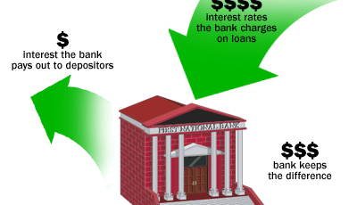
Problem background
Portuguese retail bank marketing long-term deposit offer to existing customers
Long-term deposits
Fixed investment term, usually 1 to 5 years
Safe investments
Very appealing to conservative, low-risk investors
Marketing channel used – Telemarketing

Slide 3
DATA at a glance
Data Source
Publicly available on UCI website
CSV format
Data from external sources has been used during cost-benefit analysis
Data
Data collected is from May 2008 to Nov 2010
21 attributes and 41188 observations
20 independent variables – client data, call data, socio-economic factors and campaign data

Slide 4
GOAL
Prediction about customers that are most likely to accept term deposit offer
Metric – Campaign profitability
End goal is to Maximize campaign profitability
Evaluate multiple machine learning algorithms and shortlist the one providing highest Profitability

Slide 5
DATA WRANGLING
Missing value treatment
6 variables with missing values
‘Unknown’ data converted to numpy NaN
Based on analysis done during EDA phase,
Default, loan, housing variables have been dropped
VARIABLE | % MISSING VALUES
job | 0.8
marital | 0.2
education | 4.2
default | 20.9
housing | 2.4
loan | 2.4
ALL OTHER VARIABLES | 0

Slide 6
EXPLORATORY DATA ANALYSIS
Features
Non-linearity with age variable
Chi-square
Data Normalization
Multi-collinearity among macroeconomic factors
Principal Component Analysis
Eigen values and scree plot

Slide 7
EXPLORATORY DATA ANALYSIS Dependent Variable (y)
11.2% of the customers have accepted the offer
88.8% of them have rejected it
Highly imbalanced dataset

Slide 8
EXPLORATORY DATA ANALYSIS Independent variable – Job
Retired category
Average age – 62yrs
Highest conversion rates
Student category
No consistent source of income
Most likely to look for avenues that can grow their savings without having inherent risks
Promising category for our campaign

Slide 9
EXPLORATORY DATA ANALYSIS Independent variable - AGE
Age is inversely proportional to investment risk appetite – Study by Dale Kintlez
Young adults contradicted observations made in the study
Observed non-linear conversion rates with Age
Chi-square results confirmed a presence of significant difference in response with Age
Chi-tabular < Chi-calculated(994.0), p-value <0.05

Slide 10
EXPLORATORY DATA ANALYSIS Months of the year
Portuguese tax year runs concurrently with the calendar year - 1 January to 31 December
Individuals hold liquid cash until year-end in anticipation of unexpected expenditures over the course of that year
While locking funds in low-return investments such as term deposits in initial months itself might not be a good decision, year-end could be a good time to invest in them in order maximize tax benefits
Data ranges from May 2008 to Nov 2010, thus reducing the possibility of random occurrences to a good extent.

Slide 11
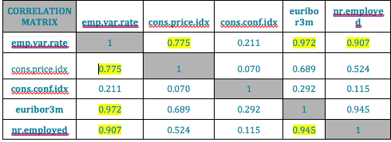
EXPLORATORY DATA ANALYSIS Important Features
Macro Economic factors, Multi-collinearity & PCA
High correlation among employee variable rate, euribor3m, nr.employed and cons.price.idx
PCA has been incorporated on the dataset to overcome this issue
Data has been normalized to bring all continuous values onto a common scale and reduce biases
Scree plot shows the fraction of variance explained by each PC and helps with identifying maximum number of components required to represent all variables considered for PCA

Slide 12
EXPLORATORY DATA ANALYSIS Important Features
Scree Plot observations:
Top 3 PCs cater to 97% of variance and hence these have been considered to replace all the macroeconomic factors
These PCs have been merged with the variables remaining after performing EDA, to arrive at our final dataset.
Variables in final dataset:
Age category, type of Job, Marital status
Education, Month, Day of week
Number of calls made, dependent variable
PCA1, PCA2, PCA3

Slide 13
Machine learning Models
Logistic Regression
Performance on original data
Data rebalancing
Regularization
Model Evaluation
Random Forest Classifier
Regularization
Model Evaluation
Support Vector Machine
Regularization
Model Evaluation

Slide 14
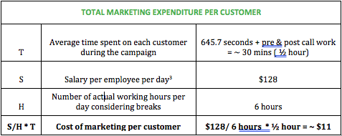
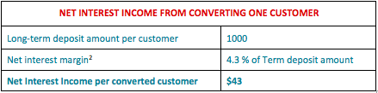
Evaluation Metrics
Profitability
Cost-Benefit Analysis

Slide 15
Profitability (Contd..) Profitability= $43*(true positives) - $11*(true positives + false positives)
Advantages of Profitability
Best performance measure for this business need
Evaluating direct financial impact of model on campaign
Unbiased evaluation inspite of having imbalanced data unlike regular metrics such as precision, accuracy and F1 scores
ROC AUC
Advantages of ROC AUC
General metric
Deals well with situations where data is imbalanced like in our business case
Evaluation Metrics

Slide 16
BASELINE PERFORMANCE
Conversion rate for this campaign - 11.2%
Out of the total 41188 customers contacted,
4613 accepted offer
36575 rejected offer
Profitability = $43(Total converts)-$11(Total customers contacted)
= $43(4613)-$11(41188)
= $ 198,359 - $ 453,068
= (- $ 254,709)
Overall, this campaign made a loss of $254,709
Goal is not only to obtain profits but also to develop a model that can maximize it

Slide 17
Logistic Regression ORIGINAL Imbalanced data
Threshold at which profitability is the highest is: 0.22
Regularization Parameter C : 100
Maximum achievable profitability with the model is: $ 10,963
ROC AUC: 0.7801

Slide 18
Logistic Regression RESAMPLED DATA
 | Upsampled Data | Downsampled Data
Final Regularization parameters | C = 100 | C = 100
Threshold | 0.68 | 0.69
ROC AUC | 0.7837 | 0.7808
Profitability | $ 10,806 | $ 10,679
Profitability at varying thresholds

Slide 19
RANDOM FOREST CLASSIFIER
Threshold at which profitability is the highest is: 0.23
Regularization Parameters
min_samples_leaf = 10
min_samples_split = 2
n_estimators = 50
Maximum achievable profitability with the model is: $ 11,164
ROC AUC: 0.7928

Slide 20
Support vector machine
Threshold at which profitability is the highest is 0.1
Regularization Parameters
Kernel= RBF
C = 0.1
gamma = auto
Maximum achievable profitability with the model is: $ 8,147
ROC AUC: 0.6876

Slide 21
conclusion
 | Profitability | ROC AUC
Logistic Regression | $10,963 | 0.7801
Random Forest Classifier | $11,164 | 0.7928
Support Vector Machines | $8,147 | 0.6876
Random Forest Classifier is the best out of the three models evaluated
Provided an increase in profitability by ~104 % over baseline model
Maximum Campaign profitability of $11,164 with this RFC

Slide 22
Its not over….

Slide 23
Future study
From the analysis done during this study, few variables had potential to help with other problematic areas faced by managers; Resource allocation & planning
Age – inconsistency could be analyzed in detail by conducting personal interviews with individuals
Additional data can be gathered to arrive at actual profitability instead of assumptions made in this study to improve accuracy of the model
This model can be generalized and applied to other investment campaigns as well by tuning parameters accordingly

Slide 24
THANK YOU Any questions?

